Slide 1
A Deep Neural Network for Network Intrusion Detection
Name: Yash Patel
Guide: Dr. Radhika

Slide 2
Progress
Data preprocessing
Model building (Logistic Regression, Decision Trees)
Evaluation of models
Comparasion of models

Slide 3
Data Preprocessing
Drop irrelevant or excess features
Apply Clamping
Apply log function to nearly all numeric, since they are all mostly skewed to the right

Slide 4
Logistic Regression
If the problem is classification based(means there are more classes in the data) or the data is too much non linear then Logistic Regression is used.
In Logistic Regression Incorrect datapoints pull the line at its own side
And correct datapoints push the line
By doing above thing the the nonlinear data will be seperated

Slide 5
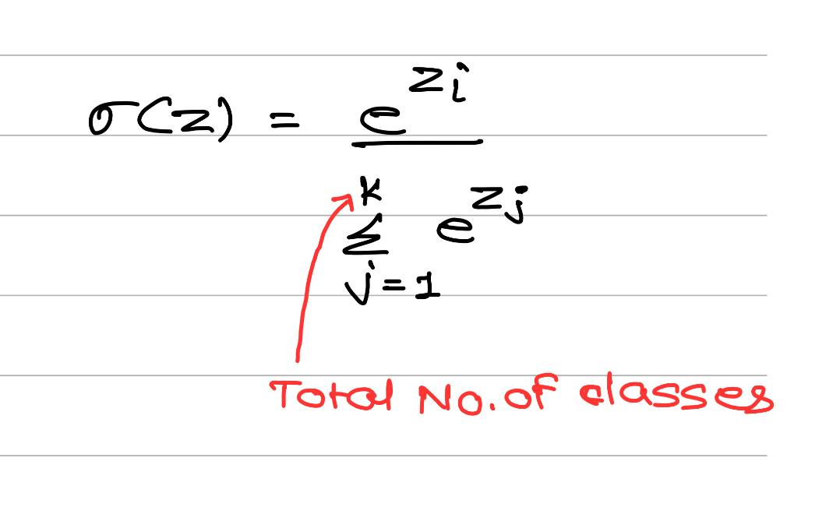
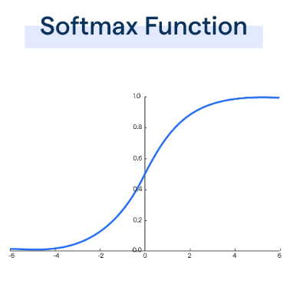
Activation function of Logistic Regression
Softmax:
Formula:
Graph:

Slide 6
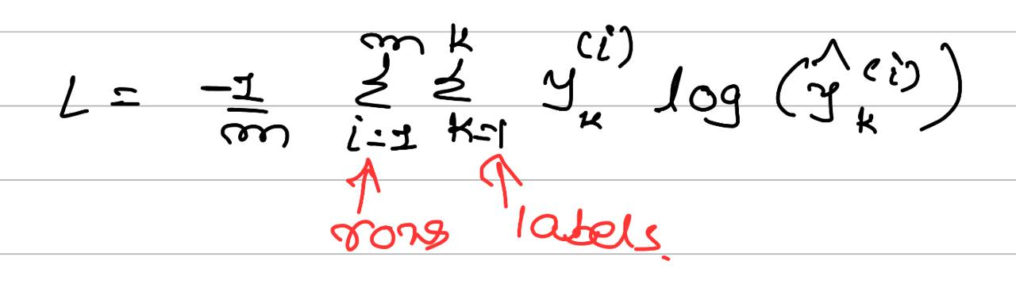
Loss function of Logistic Regression
Loss Function: Sparse Categorical Cross Entropy
Formula:

Slide 7
Decision Tree
A decision tree is a supervised machine learning algorithm used for both classification and regression tasks. It represents a flowchart-like structure in which each internal node represents a decision or a test on an attribute, each branch represents an outcome of the decision, and each leaf node represents the final prediction or class label. The topmost node in a decision tree is called the root node, and the nodes that do not have any children are called leaf nodes.

Slide 8
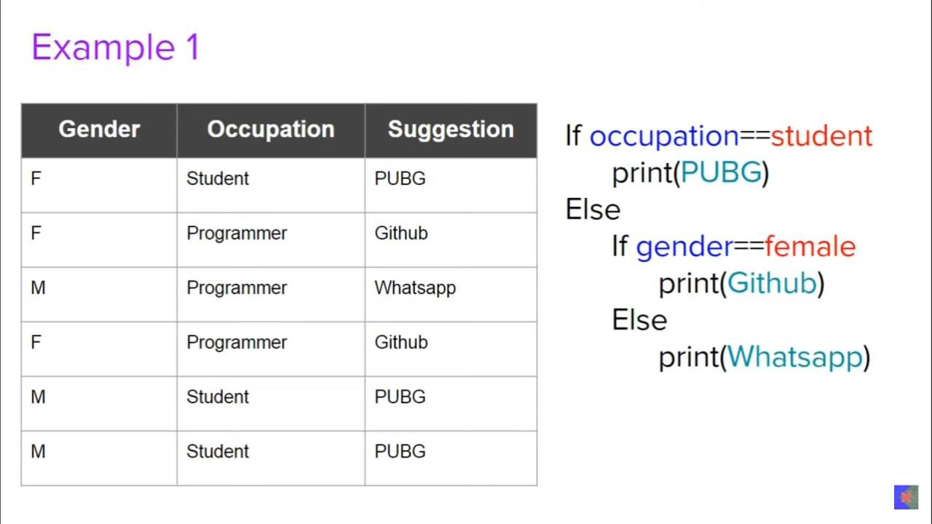
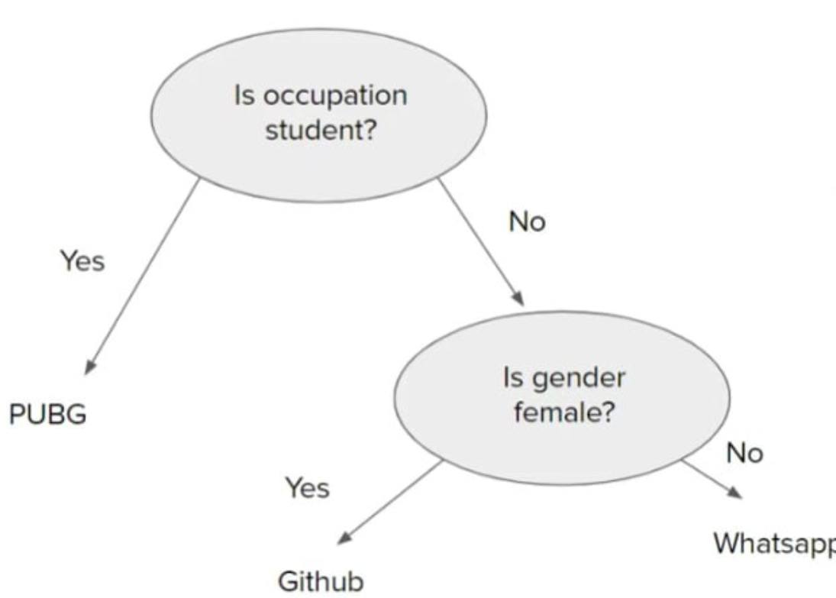
Example of Decision Tree

Slide 9
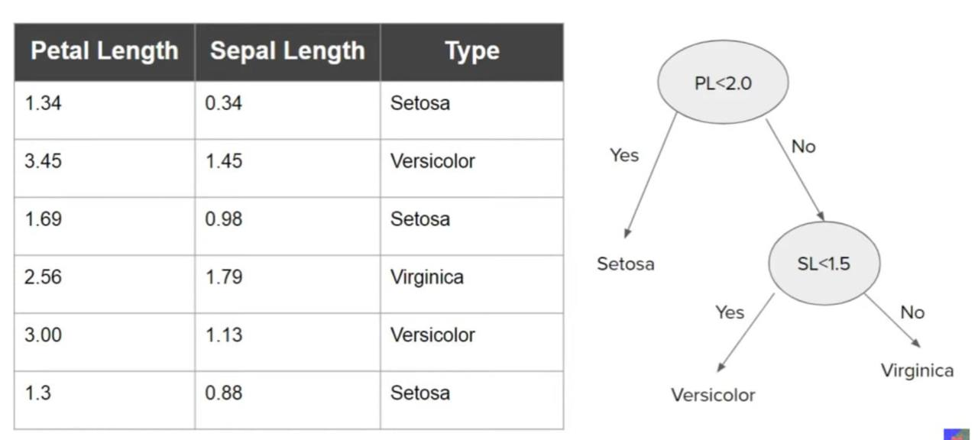
If we have numerical data then how the decision tree will be form?

Slide 10
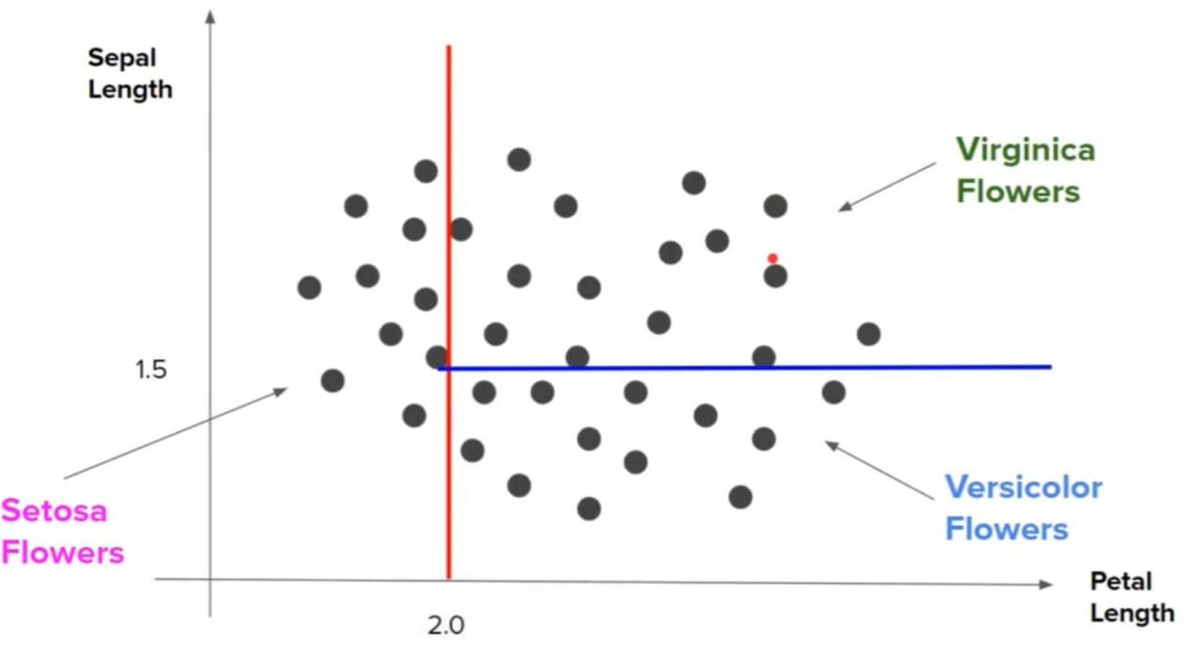
Geometric Intuition of decision trees

Slide 11
Artificial Neural Network
Imagine a computer system that learns from examples, much like how you learn from experiences. This system is called a neural network, inspired by the human brain.
Neurons:
In our network, we have small units called neurons. These are like tiny decision-makers that take input, process it, and give an output.
Layers:
Neurons are grouped into layers. There's an input layer where the network gets information, hidden layers where it figures things out, and an output layer where it gives us an answer.

Slide 12
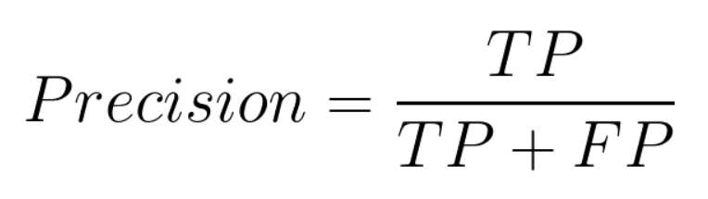
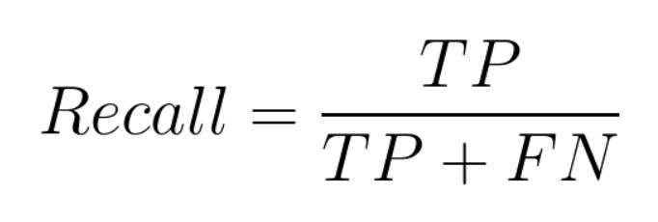
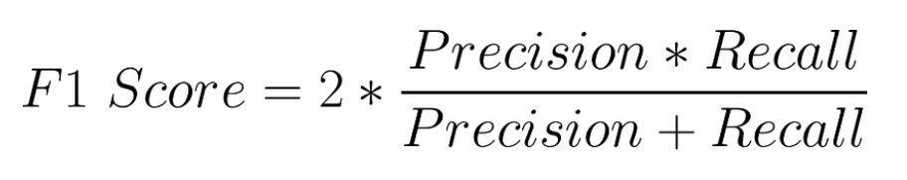
Evaluation Matrices

Slide 13
Thank You

